Slide 1
Responding to Sexual Violence:
Is there a Role for Restorative Justice?
Professor Clare McGlynn
@McGlynnClare

Slide 2
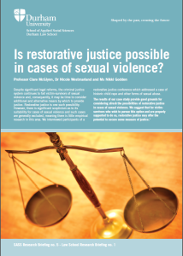
Lucy’s motivations
Police response ‘disgusted’ Lucy
Lucy felt ‘completely discounted’
Desire to ‘confront’ perpetrator
‘I just wanted him to hear me, without him twisting it really’

Slide 3
Lucy’s experiences
‘it was the first time he admitted that he had deliberately created harm and that he knew that having sexual intercourse with me would be harmful’
‘enabled me to say exactly how it had affected me, and he obviously hadn’t realised it would have such far reaching effects for me’
‘I had the last word and said that I didn’t accept his apology.’

Slide 4
Lucy: impacts of conference
The conference ‘was a really big turning point for me actually. Instead of having this whole episode of my life that I couldn’t do anything with, I could stop hating myself and put the blame where it should be’
‘why he did it’ was ‘key’
‘It was more important to have my say and have him listen than for him to go to prison’

Slide 5
What lessons can we learn from Lucy’s experiences?
survivor engagement and agreement a pre-requisite
extensive preparation and support is essential
resource and time intensive
trained and experienced facilitator vital

Slide 6
What is restorative justice?
Dialogue/conference bringing together those affected by crime to consider its impact and how the offender might make amends
Offender acknowledges responsibility
Roles of victim and offender are clear

Slide 7
When is restorative justice used?
Post-conviction:
No impact on criminal conviction, punishment or imprisonment (Lucy)
Potential impact on sentencing
Potential impact on prison release
Diversionary restorative justice:
Case is diverted from conventional criminal justice system to restorative process
Potential impact on sentence and punishment
Outside the criminal justice system entirely

Slide 8
Why consider the role of restorative justice?
Failings of conventional criminal justice system
Justice from the perspective of sexual violence survivors

Slide 9

Justice and sexual violence survivors: kaleidoscopic justice
Continually shifting pattern
Unpredictable
Lived, on-going and ever-evolving experience
Experienced and lived differently for each survivor over time

Slide 10

kaleidoscopic justice
Recognition
Consequences
Voice
Dignity
belonging

Slide 11
Possible benefits of restorative justice
Voice
‘if I was given the option whether to do the restorative process or just send someone to jail
I would rather sit down and understand why than send someone away and [be] left with unanswered questions and have to try and figure out what’s going on’.

Slide 12
Recognition and acknowledgement of offending
‘I think it’s that recognition of hurt that would mean, or does mean, justice to me personally.’
‘acknowledgement that this happened and that people believe you that it happened’

Slide 13
Recognition and acknowledgement of offending
‘I would never ever say putting somebody like that into jail would make things right, like I say, it’s admitting ... them to admit’.
‘even the restorative justice process, you know, I would have been happy to go along with because for me it was more about him understand the severity of what he’d done and acknowledging it’

Slide 14

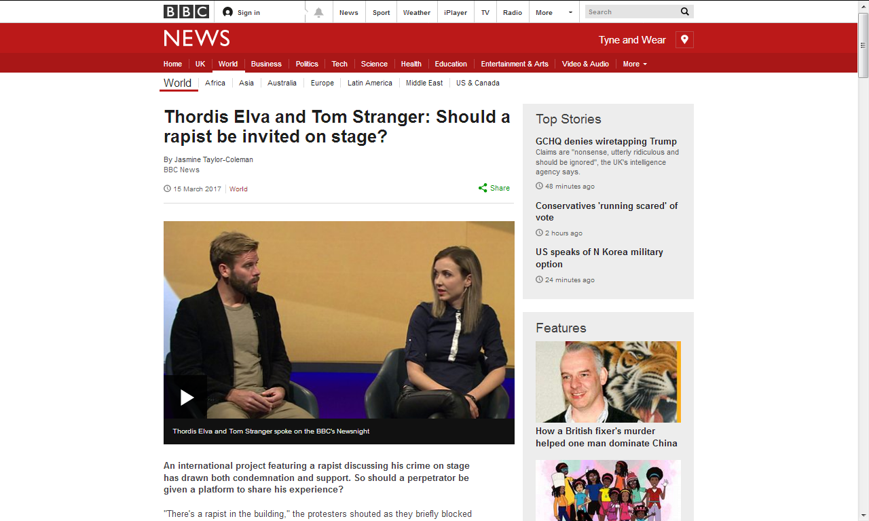
Focus on offender

Slide 15
Consequences
‘meaningful consequences’
‘I really do think it [justice] is about consequences because punishing people just doesn’t work.’

Slide 16

Challenges of restorative justice
Potential to minimise sexual violence - ‘second class’ justice
Risk of re-victimisation
Differing responses/ punishment

Slide 17
Conclusions
Starting point:
  securing justice for victim-survivors
Challenge:
  systemic problem of sexual violence, but individual survivors with specific interests and needs
Future:
reform of criminal justice system continues to be essential
but also need to move beyond one-dimensional focus on conventional criminal justice system
Restorative justice one possibility

Slide 18
Professor Clare McGlynn
@McGlynnClare
Clare.McGlynn@durham.ac.uk

